Slide 1
Process Management

Slide 2
Introduction
Process State
State Transition Diagram
Process in Memory
Process Control Block
Context Switching
Course Topics

Slide 3
Process
A program in execution.
A process will need certain resources-such as CPU time, memory, files, and I/O devices-to accomplish its task.
These resources are allocated to the process either when it is created or while it is executing.
A process is the unit of work in most systems. Such a system consists of a collection of processes:

Slide 4
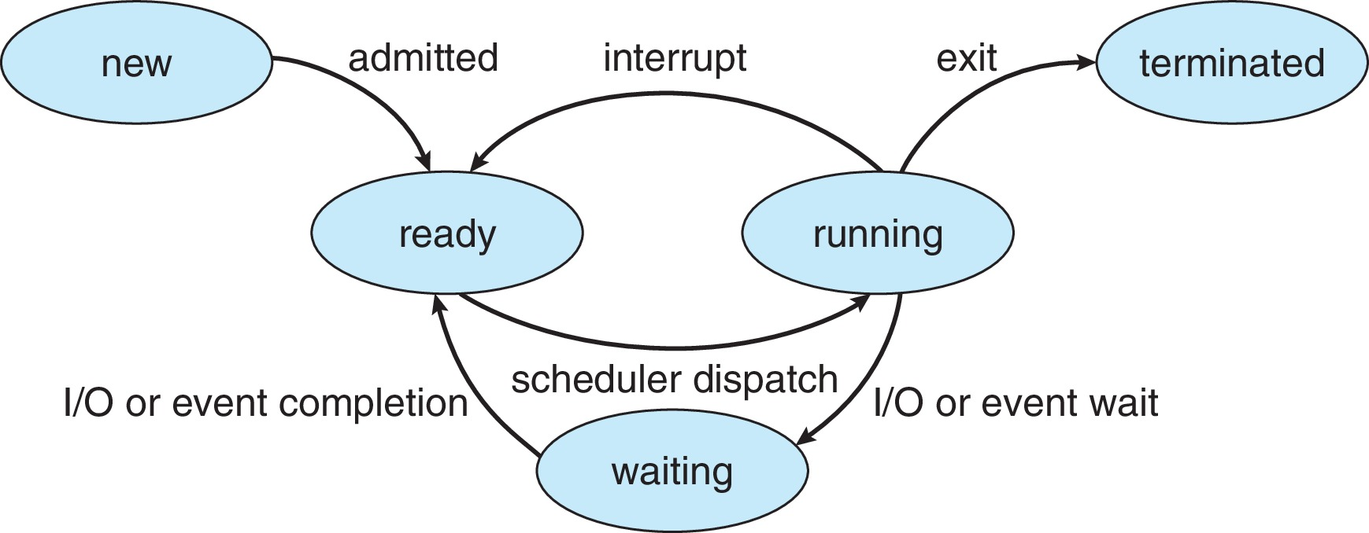
Process States
Only one process can be running on any processor at any instant, although many processes may be ready and waiting.

Slide 5
Process State
State of a process is defined in part by the current activity of that process. Each process may be in one of following states
New: The process is being created.
Ready: The process is waiting to be assigned to a processor.
Running: Instructions are being executed.
Waiting: The process is waiting for some event to occur (such as an I/O completion or reception of a signal).
Terminated: The process has finished execution.

Slide 6
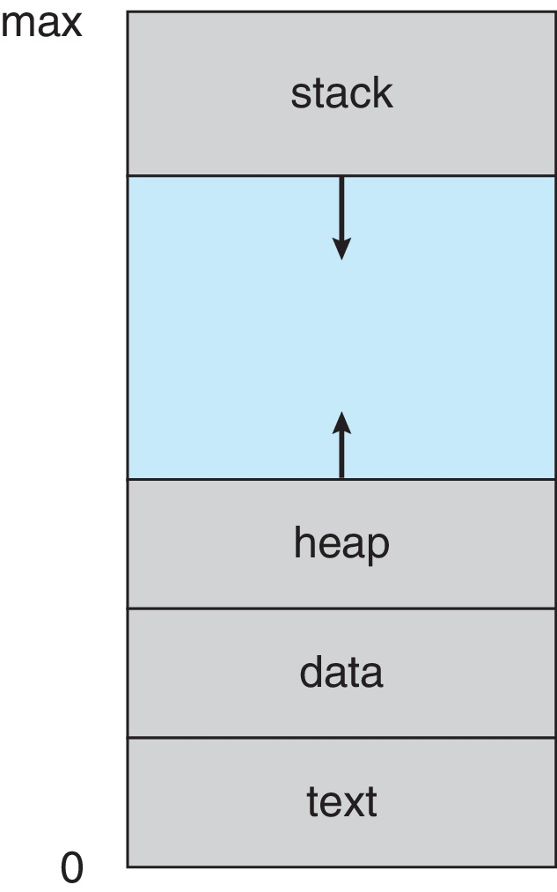
Process in Memory

Slide 7
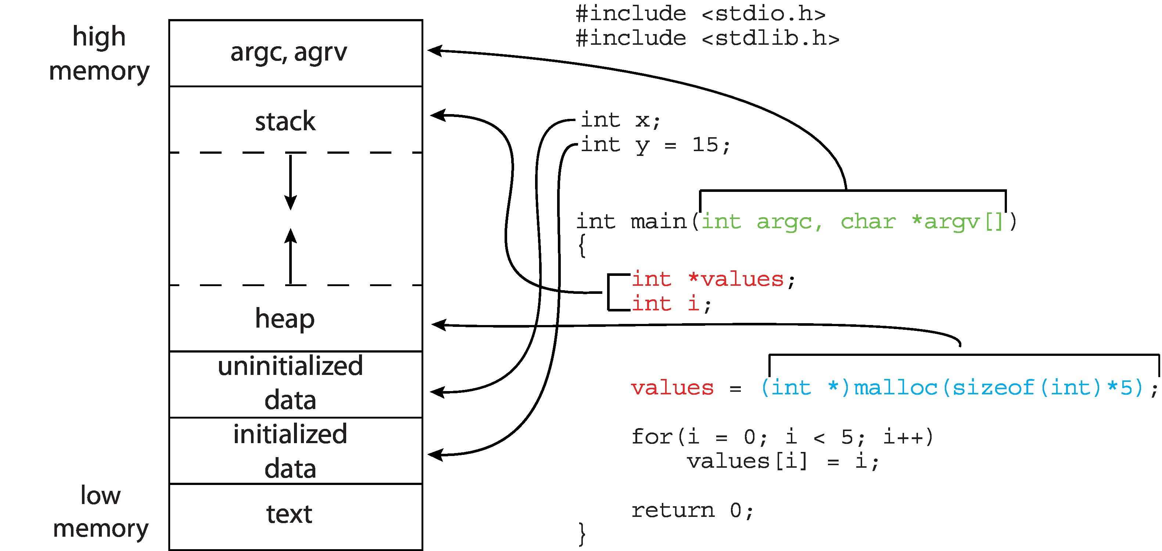
Memory Layout of a C Program

Slide 8
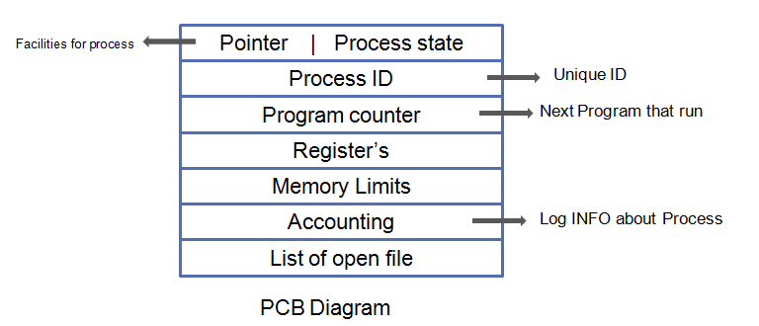
Process Control Block

Slide 9
Process Control Block
Information associated with each process(also called task control block)
Pointer: It is a stack pointer that is required to be saved when the process is switched from one state to another to retain the current position of the process.
Process state – running, waiting, etc.
Program counter – location of instruction to next execute
CPU registers – contents of all process-centric registers
CPU scheduling information- priorities, scheduling queue pointers
Memory-management information – memory allocated to the process
Accounting information – CPU used, clock time elapsed since start, time limits.
I/O status information – I/O devices allocated to process, list of open files

Slide 10
Context Switching
When CPU switches to another process, the system must save the state of the old process and load the saved state for the new process via a context switch.
Context of a process represented in the PCB.

Slide 11
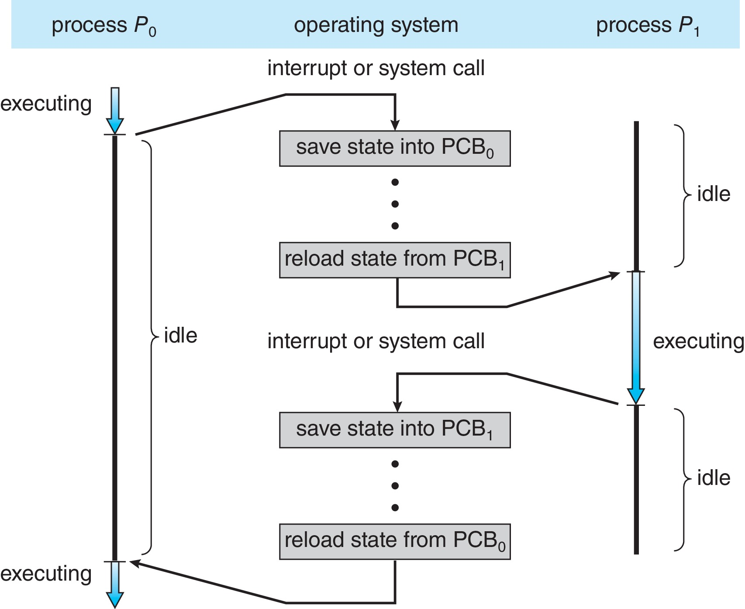
Context Switch
Context-switch time is overhead; the system does no useful work while switching.

Slide 12
Context Switch
Context-switch time is pure overhead; the system does no useful work while switching.
The more complex the OS and the PCB ➔ the longer the context switch
Time dependent on hardware support
Some hardware provides multiple sets of registers per CPU ➔ multiple contexts loaded at once

